Slide 1

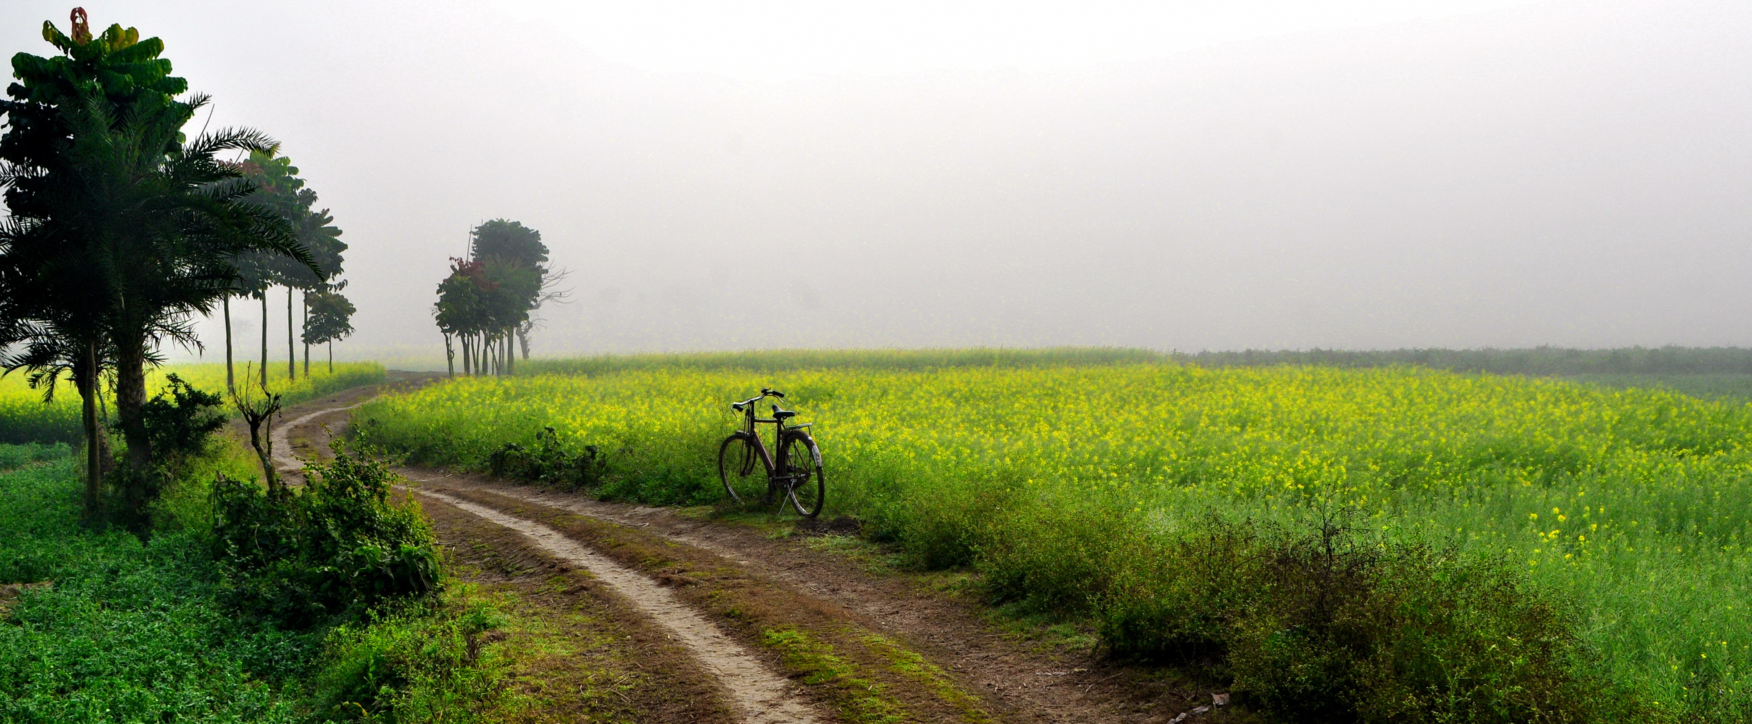
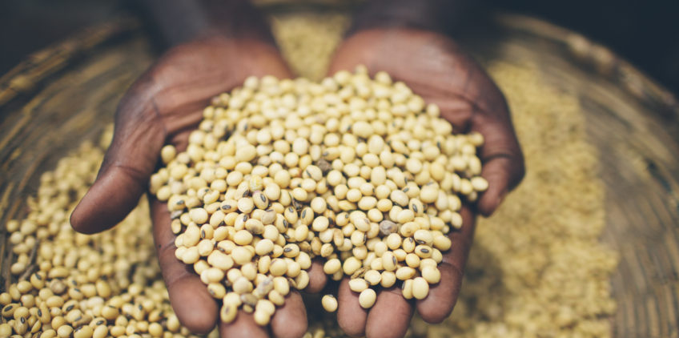


The United Republic of Tanzania
Agriculture Sector Lead Ministries
5TH ANNUAL AGRICULTURAL POLICY CONFERENCE (AAPC)
THEME:
Prioritizing Agriculture in the Industrialization Agenda for Tanzania under the
Agricultural Sector Development Program (ASDP-2)
DAY 1: TREASURY SQUARE, DODOMA
DAY 2 & 3: DODOMA HOTEL, DODOMA
13th – 15th February, 2019
Partners:

Slide 2
The Diet Transformation in Tanzania: Evidence on the double burden of malnutrition
David Tschirley, Tumaini Charles, Fortunata Chuwa, David DeYoung, Rahul Dhar
5th Annual Agricultural Policy Conference
Dodoma, Tanzania
13 February 2019

Slide 3
Brief review of what we know about changing food systems and nutrition
The 5th Annual Agricultural Policy Conference (AAPC)
Theme: Prioritizing Agriculture in the Industrialization Agenda for Tanzania under ASDP-2

Slide 4
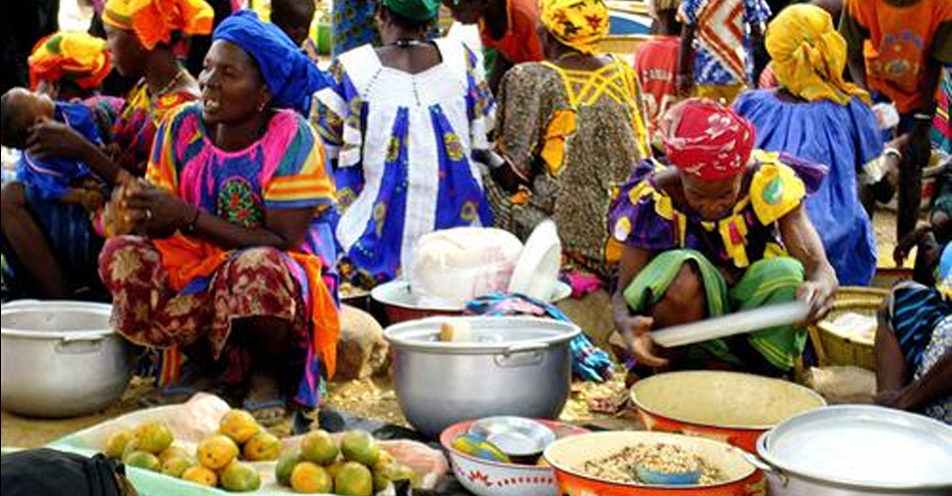
Diets are transforming in three ways (1)
Food is becoming more purchased
    About 50% of food in rural areas of Africa (by value) is purchased
    60% to 70% in Asia
The 5th Annual Agricultural Policy Conference (AAPC)
Theme: Prioritizing Agriculture in the Industrialization Agenda for Tanzania under ASDP-2

Slide 5
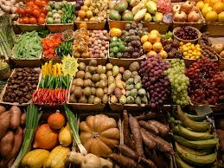
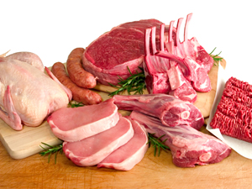
Diets are transforming in three ways (2)
  Food is becoming more perishable
    meats, dairy, fresh produce (especially fruit and new vegetables)
    Non-cereals are 50% to 70% of diets in value terms
The 5th Annual Agricultural Policy Conference (AAPC)
Theme: Prioritizing Agriculture in the Industrialization Agenda for Tanzania under ASDP-2

Slide 6

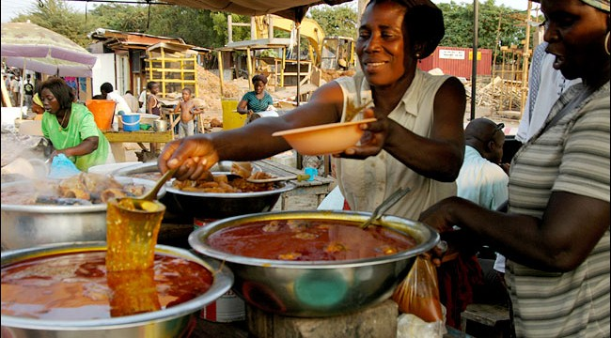
Diets are transforming in three ways (3)
Food is becoming more processed and prepared
    50% to 65% of all food
    70% to 80% of purchased
    Food away from home > 15% of food expenditure in some countries of ESA
      growing more rapidly than any other category
The 5th Annual Agricultural Policy Conference (AAPC)
Theme: Prioritizing Agriculture in the Industrialization Agenda for Tanzania under ASDP-2

Slide 7
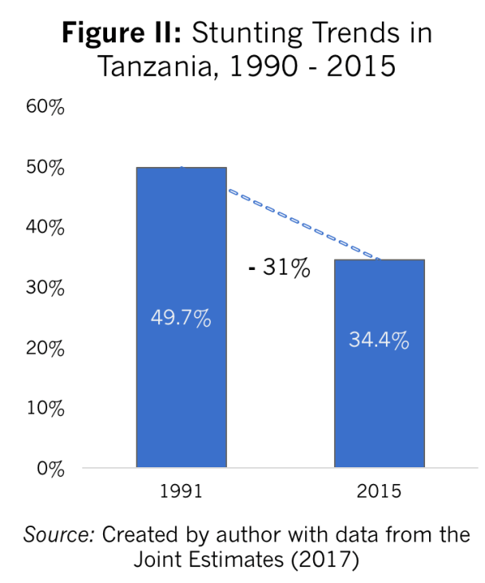
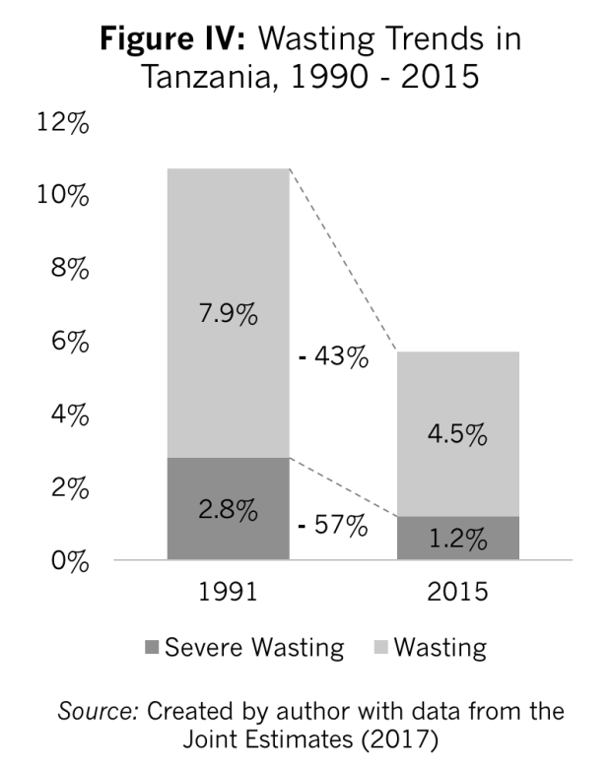
The result is a nutrition transition with falling stunting and wasting … and rising overweight, obesity, and NCDs
c

Slide 8



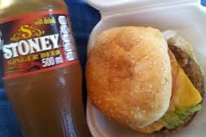

Slide 9
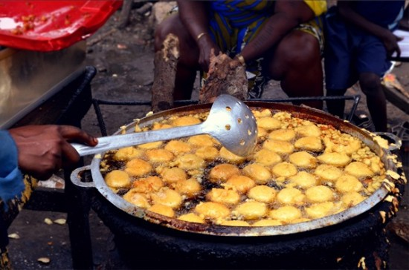

Slide 10
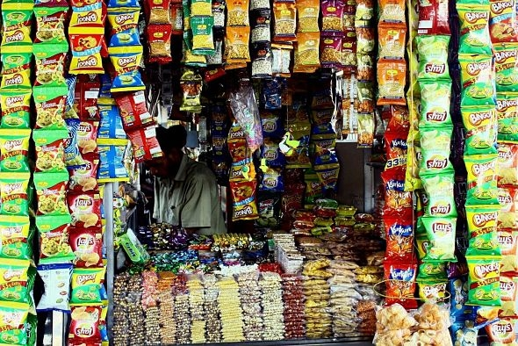

Slide 11
Evidence from 2008/09 and 2014/15 NPS on double burden
The 5th Annual Agricultural Policy Conference (AAPC)
Theme: Prioritizing Agriculture in the Industrialization Agenda for Tanzania under ASDP-2

Slide 12
New Knowledge
Double burden at household and individual levels
Spatial focus
  Rural hinterland
  Semi-rural
  Peri-urban
  Urban
Analytical focus on diet
  Unprocessed foods
  Processed foods
  Food away from home
The 5th Annual Agricultural Policy Conference (AAPC)
Theme: Prioritizing Agriculture in the Industrialization Agenda for Tanzania under ASDP-2

Slide 13
Household Level
(HHs with both stunting/under & over/obese)
(Among HHs with at least 2 people measured)

Slide 14
Household Level
(HHs with both stunting/under & over/obese)
(Among HHs with at least 2 people measured)

Slide 15
Household Level #1
(HHs with both stunting/under & over/obese)
(Among HHs with at least 2 people measured)
The LARGEST GROUP changed from
  Only stunting/ under
  To No Problem

Slide 16
Household Level #2
(HHs with both stunting/under & over/obese)
(Among HHs with at least 2 people measured)
The DOUBLE BURDEN declined

Slide 17
Household Level #3
(HHs with both stunting/under & over/obese)
(Among HHs with at least 2 people measured)
The OVER:UNDER nutrition ratio rose dramatically

Slide 18
Household Level #3
(HHs with both stunting/under & over/obese)
(Among HHs with at least 2 people measured)
The OVER:UNDER nutrition ratio rose dramatically
Nearly as many HHs now with over as under nutrition problems

Slide 19
Individual Level
(Individuals both stunted & over/obese)
(Children 7 mths – 15 yrs)

Slide 20
Individual Level
(Individuals both stunted & over/obese)
(Children 7 mths – 15 yrs)
Double burden at individual level is
  Very low
  Declining
  (Driven by decline in stunting)

Slide 21
Explaining overweight/obesity
The 5th Annual Agricultural Policy Conference (AAPC)
Theme: Prioritizing Agriculture in the Industrialization Agenda for Tanzania under ASDP-2

Slide 22
Probit results at individual level
(Pooled data, 2008/09 & 2014/15, all measured individuals)
Major positive impacts (increasing O/O)
  Income and wealth
  Diet: eating processed foods
  Activity level
  Living in an urban area
Education (of individual or parents) has no discernable effect
The 5th Annual Agricultural Policy Conference (AAPC)
Theme: Prioritizing Agriculture in the Industrialization Agenda for Tanzania under ASDP-2

Slide 23
Impact of Diet #1
Diet (shares of food type)
Own prodn | -0.0109
Unprocessed purchased | -0.00172
Low processed | 0.0734**
High processed | 0.137***
Ultra processed | 0.0807*
Food away from home | 0.0609**

Slide 24
Impact of Diet #1
Diet (shares of food type)
Own prodn | -0.0109
Unprocessed purchased | -0.00172
Low processed | 0.0734**
High processed | 0.137***
Ultra processed | 0.0807*
Food away from home | 0.0609**
Unprocessed food has no impact

Slide 25
Impact of Diet #1
Diet (shares of food type)
Own prodn | -0.0109
Unprocessed purchased | -0.00172
Low processed | 0.0734**
High processed | 0.137***
Ultra processed | 0.0807*
Food away from home | 0.0609**
Unprocessed food has no impact
All processed food has a large positive impact

Slide 26
Impact of Diet #3
Impact of moving from 20th to 80th percentile in processed food consumption
Processed food share
Predicted overwt/obesity %
26%

Slide 27
Impact of activity, place of residence #1
Spatial
Rural hinterland | -0.0366***
Semi-rural | -0.0275***
Peri-urban | -0.0216***
Activity
1.agric | -0.0147**
1.wage | 0.0341***
1.self | 0.0782***

Slide 28
Impact of activity, place of residence #1
Spatial
Rural hinterland | -0.0366***
Semi-rural | -0.0275***
Peri-urban | -0.0216***
Activity
1.agric | -0.0147**
1.wage | 0.0341***
1.self | 0.0782***
The more RURAL your residence, the less likely you are to be O/O

Slide 29
Impact of activity, place of residence #1
Spatial
Rural hinterland | -0.0366***
Semi-rural | -0.0275***
Peri-urban | -0.0216***
Activity
1.agric | -0.0147**
1.wage | 0.0341***
1.self | 0.0782***
The more RURAL your residence, the less likely you are to be O/O
(Likely reflects combination of activity and food environment)

Slide 30
Impact of activity, place of residence #2
Spatial
Rural hinterland | -0.0366***
Semi-rural | -0.0275***
Peri-urban | -0.0216***
Activity
1.agric | -0.0147**
1.wage | 0.0341***
1.self | 0.0782***
If you work off the farm, you are more likely to be O/O
(indicator of activity)

Slide 31
Summing up
A plurality of households now suffers NEITHER from under-nutrition nor from over-nutrition
The balance of nutritional challenges has shifted dramatically
Both diet and activity appear to be major contributors
The double burden is:
  Very uncommon among individuals (~ 2%)
  More common but still low at household level (~12%)
  A major issue at national level

Slide 32
For policy makers
Make sure policy is conducive to economic growth
Continue to invest in known effective programmatic interventions for stunting
Overweight and obesity are rising fast
  Need much better understanding of
    How food environments are changing in rural and urban areas
    How they influence consumers’ food attitudes & practices
  Start NOW to look at regulatory approaches being tried in Latin America

